Slide 1
Getting Evaluation Questions Right: The First Step in Quality Evaluation Presented at Office of Personnel Management Federal Employee Development Evaluation Conference September 26, 2016
Michael coplen
Senior Evaluator
Office of Research, Development & Technology
Federal Railroad Administration
U.S. Department of Transportation
Notes:
By way of hands:
How many of you are responsible for funding and managing training and educational programs?
How many are responsible for implementing and evaluating, but not funding, training and education programs?
How many are familiar with AEA? Program evaluation standards? AEA Guiding Principles?
What do you hope to get from this presentation?
One of the evaluation standards, as you will see later in my presentation, is Utility -
“to ensure evaluations serve the information needs of the intended users.” By design, it is the first evaluation standard listed, and perhaps the most important.
Well-written, big picture evaluation questions is the first step in evaluation planning and developing useful evaluations. One of my presentation goals is to help foster evaluative thinking and evaluation-oriented leaders in federal programs to help you improve your programs and perhaps make them more useful.
So even though this presentation is not an “evaluation” per se, I am taking an evaluative approach by asking two key questions:
Who is my intended audience?
How do they intend to use the information I am presenting here?
In doing so, I hope to customize my presentation just a bit more so that you will find the information presented more useful to your needs.
So, Lesson 1 in developing good evaluation questions. Always start by asking two key questions: 1) who is your intended audience ,and 2) how do they intend to use the results of the program?
Example: asked for advice on evaluating a federal research program portfolio. I asked the evaluators who was asking for the evaluation, and why. They couldn’t tell me!
Feel free to stop and ask questions along the way.

Slide 2
DISCLOSURE The views and perspectives in this presentation are solely those of my own, and do not purport to represent those of the Federal Railroad Administration, the Department of Transportation, or the federal government.

Slide 3
Overview
Evaluation context: history, definition, roles, evaluation frameworks.
What are some common flaws in developing evaluation questions?
What constitutes good quality evaluation questions?
What? So what? Now What?
Exemplar program with illustrative questions
How do quality evaluation questions drive useful, actionable evaluation?

Slide 4
What is evaluation?
Evaluation is the systematic application of defensible criteria to determine the value, merit or worth (i.e. quality, utility, effectiveness, or significance) of something.
Program evaluations answer big picture questions about programs, like:
How well was the program designed?
To what extent did the program achieve its goals?
Are the results worth what the program costs?
Should it continue?
How can it be improved?

Slide 5
Why Evaluation in Federal Programs?
Congressional Mandates
Government Performance and Results Act (GPRA, 1993)
Program Assessment Rating Tool (PARTs, 2002)
GPRA Modernization Act of 2010
OMB Memos
M-13-17, July 26, 2013: Next Steps in the Evidence and Innovation Agenda
M-13-16, July 26, 2013: Science and Technology Priorities for the FY 2015 Budget
M-10-32, July 29, 2010: Evaluating Programs for Efficacy and Cost-Efficiency
M-10-01, October 7, 2009: Increased Emphasis on Program Evaluations
M-09-27, August 8, 2009: Science and Technology Priorities for the FY2011 Budget
GAO reports
Program Evaluation: Strategies to Facilitate Agencies’ Use of Evaluation in Program Management and Policy Making (June, 2013)
Program Evaluation: A Variety of Rigorous Methods Can Help Identify Effective Interventions (GAO-10-30, November, 2009)
Program Evaluation: Experienced Agencies Follow a Similar Model for Prioritizing Research (GAO-11-176 , January, 2011)
Federal Evaluation Working Group
Reconvened in 2012 to help build evaluation capacity across the federal government
“[We] need to use evidence and rigorous evaluation in budget, management, and policy decisions to make government work effectively.”
Notes:
There are many reasons for doing quality evaluations.
GPRA and GPRAMA are federal laws that require Federal agencies to evaluate the extent to which their programs achieve intended objectives.
GPRAMA requires an agency describe in its Strategic Plan that program evaluations be used in establishing or revising agency goals and objectives. The law also requires a schedule for future program evaluations.
Agencies must report summary findings of program evaluations in their Performance Updates.
In support of GPRAMA, OMB has strongly advocated for evaluation capacity building through numerous OMB Memos and directives to federal agencies.
GAO is well-known and recognized for its summary reporting on the methodologies and effectiveness of program evaluations in the federal government, helping advocate and facilitate evaluation use.
A number of evaluation working groups and federal listservs have sprung up in recent years as information sharing forums on program evaluation, helping agencies build more effective evaluation practices.
The bottom line, however, is that quality evaluation works. It is a model of evidence-based policy and decision-making. When done well, evaluations also provide :
Transparency
Accountability
Opportunities to continuously improve government programs

Slide 6
Assessing the logic of Evaluation in Federal Programs
ACTIVITIES
OUTPUTS
OUTCOMES
IMPACTS
Funded
Activity
“Family”
______
e.g.,
Scientific
Research
Technology
Development
Deliverables
Products
Application
of Research
Behavior
Change
Data Use: Users
Adopt Guidelines,
Standards
or Regs
Technical
Report(s)
Frameworks
Model(s)
Changing
Practices
Emergent
Outcomes
Positive
Knowledge Gains
Research to
Impact GAP
Negative Effects
Unintended Consequences
EVALUATION
Notes:
Most federal R&D programs have a family of funded activities, such as technology and engineering development, basic and applied research.
Typical outputs of that funded research are often technical reports and other deliverables and products, including new technologies or forecasting models.
Sometimes those reports and products get used, sometimes not. All too often we assume that because we produced something of quality that it will get used. But there are many things going on across that imaginary line between research and effective practice that impede or prevent the use of research.
Evaluation can help us bridge that gap between research and practice, by systematically collecting and analyzing information about context, alternative approaches, potential barriers to implementation, and by documenting the impacts of pilot demonstrations.
We need to keep the end game in mind. What makes evaluations actionable is developing a good set of “big picture” evaluation questions, something that will provide incisive, evaluative answers that will help guide key policy and decision-making.

Slide 7
The Research-Evaluation Continuum
Notes:
Sometimes, as engineers, trainers and scientists we get hung up on the methodologies we were taught in our fields of specialty. We develop “research questions” or narrowly focused “training-related” questions, instead of broader-based “evaluation questions.”
I’m not saying those methodologies aren’t important. What I’m suggesting is that we need to keep those “big picture” evaluation questions in mind when designing and implementing our programs. What can we add to what we are already doing to help strengthen our programs? What are the core evaluation questions?
As federal program managers and federal agents we have a fiduciary responsibility to the American public, to maximize the impact of government spending. Our programs, procured by money invested by the American people, should prove to be useful for their intended purposes.
We can do that by asking the right evaluation questions, then using whatever methodology is most important for answering and reporting out on those questions.
The table above highlights some of the similarities and differences between research and evaluation. As you can see, when we move toward the evaluation side of things there is a tendency to incorporate more qualitative elements through interviews and focus groups, which is often what is needed to identify the critical needs. For those of you who are trainers you might think about what you were to put in rows for the column on the left if it were Training as opposed to Research, and asking the fundamental question perhaps about the framework or models (?) typically used to evaluate your programs and how they fit with a broader evaluative framework.
The problem focusing too much on answering research questions as opposed to evaluation questions is that you get descriptive, causal answers usually at the micro level. You might get the size of an outcome shift, for example, but nothing that describes its inherent worth, or associated problems, of the program to guide decision-making. It’s all very rigorous and scientific, but not very actionable for those who were looking forward to the results.

Slide 8
Evaluation Framework: Roles of Evaluation
 | FORMATIVE | SUMMATIVE
When: | Before or during R&D projects/programs | After R&D projects/programs
Purpose: | To guide: Program planning Program design Implementation strategies | To assess: Completed projects or project lifecycles Accomplishments Impacts To meet accountability requirements
Primary Focus: | To improve programs | To prove program merit or worth
Notes:
To better understand the evaluation planning process and writing quality evaluation questions, it might be helpful to explore the two key roles of evaluation.
Formative Evaluations - are conducted before and during a project, to guide project planning, design and implementation and to help assure success. These evaluations primarily seek to improve a program.
Summative Evaluations - are conducted after the fact, to assess completed projects or cycles of a project in order to take stock of accomplishments, understand a program’s impact, and meet accountability requirements. These evaluations primarily seek to prove or demonstrate a program’s merit or worth.
When we invest in nursing our projects and programs in their formative stages, before they are implemented, we are much more likely to reach measureable impacts for intended users.
What this implies is that the nature and purpose of your evaluation questions will be different, depending on whether you are conducting a formative improvement-oriented, evaluation or a summative accountability-oriented evaluation.

Slide 9
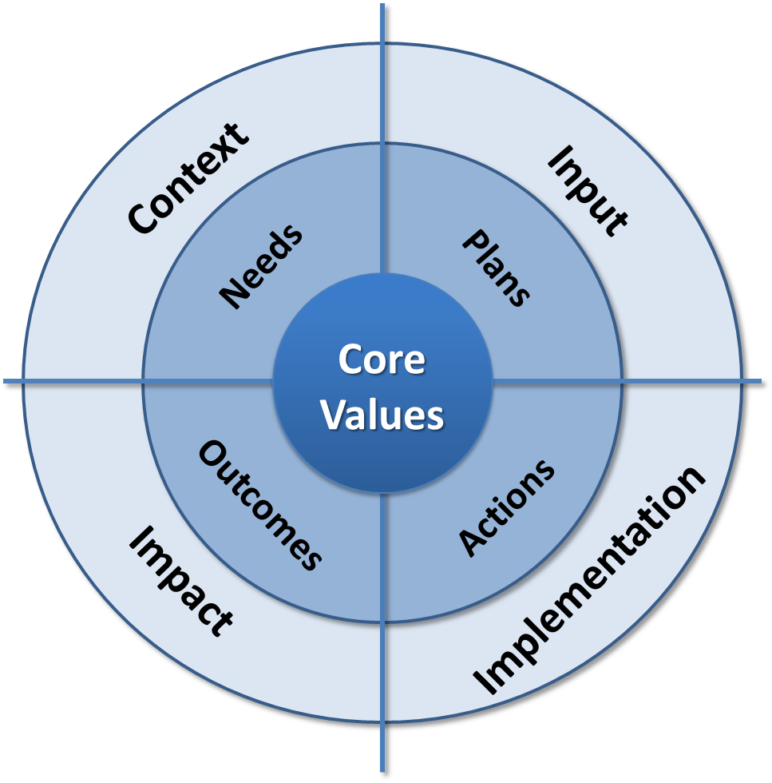
CIII Evaluation Model: (Context, Input, Implementation, Impact)
Types of Evaluation
Context (needs)
Input (design)
Implementation (process)
Impact (product)
Daniel L. Stufflebeam's adaptation of his CIPP Evaluation Model framework for use in guiding program evaluations of the Federal Railroad Administration's Office of Research and Development. For additional information, see Stufflebeam, D.L. (2000). The CIPP model for evaluation. In D.L. Stufflebeam, G. F. Madaus, & T. Kellaghan, (Eds.), in Evaluation models (2nd ed.). (Chapter 16). Boston: Kluwer Academic Publishers.
Stakeholder engagement is key
Notes:
You may also find it helpful when designing your evaluations and writing evaluation questions to think conceptually about where you are in your program, and consider using an evaluation framework.
The CIPP Evaluation Model is one of the oldest and most widely tested models in the evaluation field. I like it because of its simplicity, and have been using it for more than 15 years.
Basically, it represents four types of evaluation: context, input, process and product. When applied to research, I like to think of it as part of the research lifecycle, from assessing research needs to designing the research, to implementation, and finally to impact.
Evaluation applied to the R&D lifecycle, then, is simply the systematic collection, analysis , and reporting of information at every stage of the lifecycle to improve the quality of inputs and outputs at each stage, to maximize impacts for intended users and minimize unintended consequences.
Stakeholder engagement is the foundation of any successful program. It is especially important to incorporate stakeholder engagement strategies from the earliest stages of the process to help ensure that success.

Slide 10
Evaluation Framework: Roles and Types of Evaluation
 | Context | Inputs | Implementation | Impact
Formative Evaluation (proactive) | Identifies: - Needs - Problems - Assets Helps set: - Goals - Priorities | Assesses: Alternative approaches Develops: - Program plans - Designs - Budgets | Monitors: - Implementation - Documents issues Guides: - Execution | Assesses: +/- outcomes Reassess: Project/program plans Informs: - Performance metrics - Strategic planning - Policy development
Summative Evaluation (retroactive) | Assesses: Original program goals and priorities | Assesses: Original procedural plans and budget | Assesses: - Execution | Assesses: - Outcomes - Impacts - Side effects - Cost-effectiveness
Notes:
When you map the types of evaluation against the two roles of evaluation, you can readily see how this framework can help guide your evaluation questions.
Both formatively and summatively, you can:
assess your needs, goals and priorities
design a quality program based on best available evidence of what works and what doesn’t
applying your intervention, monitoring the implementation for continuous improvement, and
Assess your program impacts.
Unfortunately, we don’t always bring the best available evaluation evidence to bear on the process, which can limit our success. Sometimes we fail to state the broad purpose of the evaluation; we don’t identify or document the “outcomes of interest” for those who are intended to use the program; we have no clear sense of the overall strategic direction we are heading or how this particular evaluation fits with the broader purpose of other related programs. So we chase down tangential rabbit holes hoping to arrive at answers to elusive ill-defined questions.
Applying evaluation methods and standards to the process substantially improves the likely outcomes.
Example of MC study of irregular, on-call work schedules. Answered, and published, in a peer-reviewed journal the answer to a research question on shorter-than vs. longer-than 24-hour schedules.
So what?!

Slide 11
Evaluative Questions Framework – Illustrative Questions
 | Context | Inputs | Implementation | Impact
Formative Evaluation | Who asked for the evaluation? Why? What are the needs? Intended users and uses? What are the highest priority needs? What is the existing context driving those needs? | Given the need, what are the most promising alternative approaches? How do they compare? (potential success, costs) How can this strategy be most effectively implemented? Any potential barriers to implementation? How to mitigate barriers? | To what extent is the program proceeding on time, within budget, and effectively? Is the program being implemented as designed? Are implementation challenges being addressed? If needed, how can the design be improved? | To what extent are intended users (states, organizations, public) using the program? What other indicators of use, if any, have emerged that indicate the program is being used? What are some emerging outcomes (positive or negative)? How can the implementation be modified to maintain, measure and sustain long-term success?
Summative Evaluation | To what extent did the program address the high priority needs? | What strategy was chosen and why, compared to other viable strategies (re. prospects for success, feasibility, costs)? | To what extent was the program carried out as planned, or modified with an improved plan? | To what extent did this program effectively address the needs? Any unanticipated negative or positive side effects? What conclusions and lessons learned can be reached (i.e., cost effectiveness, stakeholder engagement, program effectiveness)?
Notes:
Let’s look at the same evaluative framework, with the types of evaluation mapped against the two roles of evaluation. This time I’ve included illustrative questions that you might use as guideposts for developing your core evaluation questions, depending on the stage of your program.

Slide 12
Exemplar Evaluation Questions: Educational Website Development and Implementation

Slide 13
An Educational Website: Evaluation Framework – Illustrative Questions
 | Context | Inputs/Design | Implementation | Impact
Formative Evaluation | What are the highest priority needs for a website in the railroad industry? | Given the need for specific education and training, what are the most promising alternatives? How do they compare (potential success, costs, etc.)? How can this strategy be most effectively implemented? What are some potential barriers to implementation? | To what extent is the website project proceeding on time, within budget, and effectively? If needed, how can the design be improved? | To what extent are people using the website? What other indicators of use, if any, have emerged that indicate the website is being accessed and the information is being acted upon? What are some emerging outcomes (positive or negative)? How can the implementation be modified to maintain and measure success?
Summative Evaluation | To what extent did the website address this high priority need? | What strategy was chosen and why compared to other viable strategies (re. prospects for success, feasibility, costs)? | To what extent was the website carried out as planned, or modified with an improved plan? | To what extent did this project effectively address the need to educate railroad employees on this topic? Were there any unanticipated negative or positive side effects? What conclusions and lessons learned can be reached (i.e. cost effectiveness, stakeholder engagement, program effectiveness)?

Slide 14
High Priority Needs (Context)
WHAT? EDUCATION: Provide on-call railroaders…
Scientifically valid content on ....
Proven, practical strategies to address the real-world challenges of balancing work and life.
Personal tools to address issues identified.
anonymous assessment for employees
Diary data
WHY? BEHAVIOR CHANGE: Motivate railroaders to adjust behavior in the aspects of their lives within their individual control.

Slide 15
Target Audience/Intended Users (Context)
Primary: On-call train and engine crews
On-call employees (and their families) with specific information, on all classes of freight and passenger service on U.S. railroads
Secondary: Other active railroaders
Labor, management and others who interact with, and have influence on, these railroaders
Notes:
Primary: T&E crews
those with unpredictable work schedules, on all classes of freight and passenger service on U.S. railroads
Secondary: Other active railroaders; those who interact with, and have influence on, these railroaders
Needs assessment results → transition to next slide

Slide 16
Independent External Evaluation
Need
Large scale industry-wide project. Context is complex, contentious. Building site might not mean “they will come” or they will use it.
Integrate evaluation into project phases to ensure attention to multiple perspectives are reflected.
Evaluation Goals
Facilitate good website design, understand website use and utility.
Inform key stakeholders about merit and worth of project based on systematic assessment.
Evaluation Use
Inform project decision-making, improve design, plan implementation strategy, accountability.
Notes:
Understand website use and utility, specifically in terms of cognitive and affective outcomes (i.e., knowledge and attitudinal change)
Understand user satisfaction and utility of the website; e.g.,
Evaluate the long-term effectiveness and impact of the website,
Inform stakeholders about merit and worth of the project based on empirical research
Systematically investigate, measure, and assess all aspects of project development: process, collaboration, product, launch
Intended USE of evaluation:
Inform project decision-making
Improve website design
Plan implementation strategy
Provide evidence in accountability

Slide 17
Implementation and Impact Evaluation
Core Evaluation Question: Which company-sponsored implementation approaches promote industry-wide utilization of the website as an educational resource that increases user understanding of issues identified.
Identify and examine company developed initiatives for integrating/ implementing website into on-going training and educational programs.
Identify RR sites to pilot educational efforts in different formats using a variety of approaches.
Review the curricular/training materials developed to support the website as the primary learning tool.
Determine to what extent and in what ways these “pilot” initiatives have educational impact in the short term within the context of broad application across the industry.
Analyze data from a pre-/post-assessment of knowledge and attitudes.
“Think-aloud” cognitive interviews to understand user interest, engagement, and choice processes through website use, to obtain ongoing interface usability feedback.
Notes:
Which implementation approaches promote industry-wide utilization of the website as an educational resource that increases user understanding
Note that this question ties back to Overview slide speaker’s notes…

Slide 18
Summary
Good evaluation questions ask:
What is happening and why? (What?)
How well is it working? (So What?)
How can it be improved? (Now what?)
Who will use the evaluation results? (Intended users)
How will they use the results? (Intended uses)
“Yes, but what exactly is it,” said Deep Thought. “Once you know what the question actually is, you'll know what the answer means.“
- The Hitchhiker’s Guide to the Galaxy
Sub-questions
Notes:
Good evaluation questions are actionable. Focus on the WHAT, the SO WHAT, and NOW WHAT? Don’t get lost in details. Step back and think about what you are wanting to do. What do you need to know right now? Ask questions that matter, about programs, processes, products, and impacts.
What is happening and why? The WHAT.
How well is it working? Why or why not? The SO WHAT.
How can it be improved? What are the program impacts and lessons learned? The NOW WHAT.
Clarify and articulate who are the intended users, and how they will use the results.
It’s not enough to ask about whether your training program is related to training outcomes (a research question); you need to know how strong the link is, if it’s a causal relationship, AND whether the strength of that relationship was enough to warrant a continued investment – that’s the evaluative bit. THAT’s an actionable answer.
Attribute to Jane Davidson above. Orlando, FL presentation, 2009.

Slide 19
Guidelines for developing quality evaluation questions
Ask “big picture” questions
Usually 5-7 core questions is enough
Include sub-questions
Cover most or all of the following:
Context (what is being evaluated/why)
Input/design (what are the most promising alternatives)
Implementation (how is it working, barriers, opportunities for improvement)
Impacts (lessons learned, overall value/worth)

Slide 20
Evaluation Resources

Slide 21
Evaluation Resources
Affiliate Evaluation Associations
Washington Research and Evaluation Network (WREN)
Federal Evaluator’s Network
Evaluation Journals
American Journal of Evaluation (AJE)
New Directions for Evaluation (NDE)
Evaluation Review
Evaluation and the Health Professions
The Evaluator’s Institute (http://tei.cgu.edu)
Claremont Graduate University
The Evaluation Center (http://www.wmich.edu/evalctr/)
Western Michigan University

Slide 22
Evaluation Standards* Guiding principles for conducting evaluations
Utility (useful): to ensure evaluations serve the information needs of the intended users.
Feasibility (practical): to ensure evaluations are realistic, prudent, diplomatic, and frugal.
Propriety (ethical): to ensure evaluations will be conducted legally, ethically, and with due regard for the welfare of those involved in the evaluation, as well as those affected by its results.
Accuracy (valid): to ensure that an evaluation will reveal and convey valid and reliable information about all important features of the subject program.
Accountability (professional): to ensure that those responsible for conducting the evaluation document and make available for inspection all aspects of the evaluation that are needed for independent assessments of its utility, feasibility, propriety, accuracy, and accountability.
* The Program Evaluation Standards were developed by the Joint Committee on Standards for Educational Evaluation and have been accredited by the American National Standards Institute (ANSI).

Slide 23
Evaluation Resources
American Evaluation Association (http://www.eval.org)
3000 members in 2001
over 7100 members today
all 50 states
over 60 countries
$95/year membership, includes
American Journal of Evaluation
New Directions in Evaluation
online access to full journal articles

Slide 24
Guiding Principles for Evaluators
Systematic inquiry: Evaluators conduct systematic, data-based inquiries.
Competence: Evaluators provide competent performance to stakeholders.
Integrity/Honesty: Evaluators display honesty and integrity in their own behavior, and attempt to ensure the honesty and integrity of the entire evaluation process.
Respect for people: Evaluators respect the security, dignity and self-worth of respondents, program participants, clients, and other evaluation stakeholders.
Responsibility for general and public welfare: Evaluators articulate and take into account the diversity of general and public interests and values that may be related to the evaluation.
(http://www.eval.org)

Slide 25
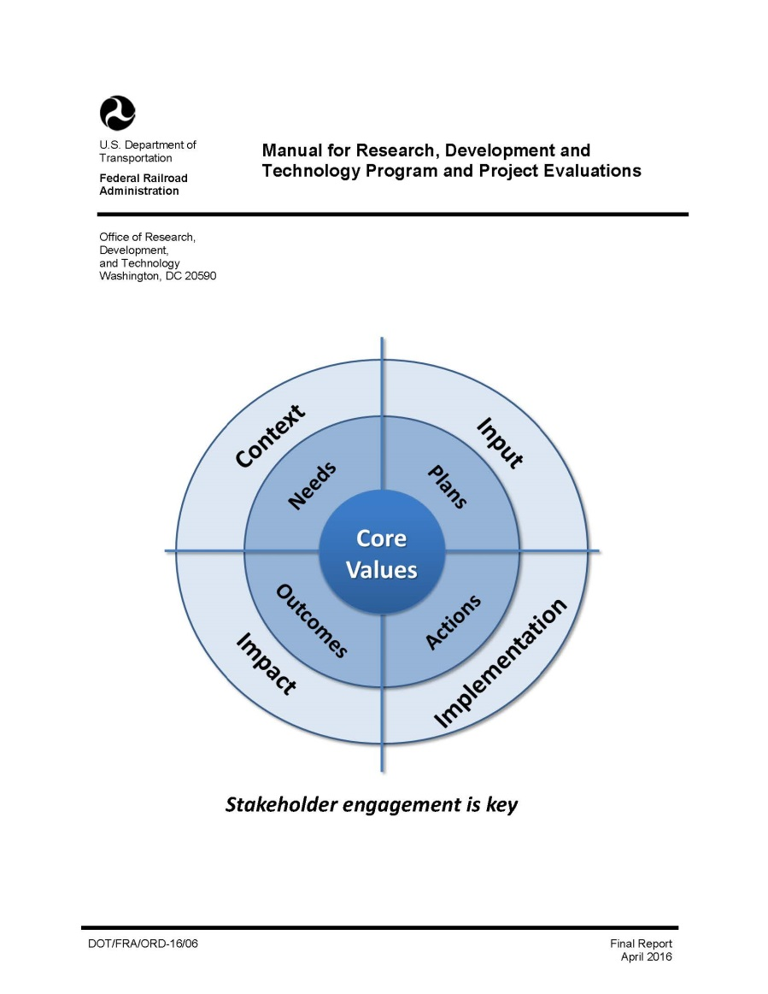
Evaluation Resources
http://www.fra.dot.gov/eLib/Find#p1_z25_gD_kEvaluation%20Implementation%20Plan http://www.fra.dot.gov/eLib/details/L17399#p1_z5_gD_kmanual

Slide 26
Evaluation Resources
Stufflebeam, Daniel, and Coryn, Chris L. S. (2014). Evaluation Theory, Models, & Applications. Jossey-Bass: A Wiley Brand.
2nd edition

Slide 27
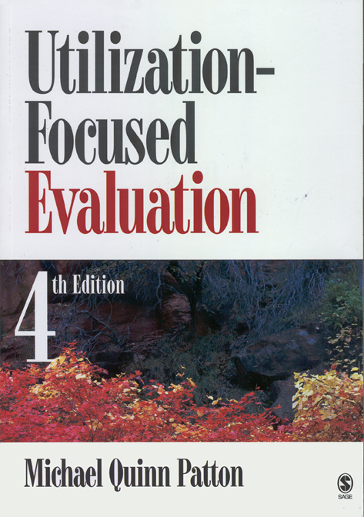
Evaluation Resources
“Intended use for intended users”
4th edition, 2008

Slide 28
Evaluation Resources
Davidson, E. J. (2004). Evaluation methodology basics: The nuts and bolts of sound evaluation. Thousand Oaks, CA: Sage.

Slide 29
Thank you! Michael Coplen, M.A. Senior Evaluator Office of Research, Development & Technology Federal Railroad Administration U.S. Department of Transportation 202-493-6346 michael.coplen@dot.gov

Slide 30
EXTRA SLIDES

Slide 31
Evaluation Standards *Guiding principles for conducting evaluations
Utility (useful) | Feasibility (practical) | Propriety (ethical) | Accuracy (valid) | Evaluation Accountability (professional)
Evaluator Credibility Attention to Stakeholders Negotiated Purposes Explicit Values Relevant Information Meaningful Processes & Products Timely & Appropriate Reporting Concern for Consequences & Influence | Project Management Practical Procedures Contextual Validity Resource Use | Responsive & Inclusive Orientation Formal Agreements Human Rights & Respect Clarity & Fairness Transparency & Disclosure Conflicts of Interest Fiscal Responsibility | Justified conclusions & decisions Valid Information Reliable Information Explicit Program & Context Description Information Management Sound Design & Analyses Explicit Evaluation Reasoning Communication & Reporting | Evaluation Documentation Internal Metaevaluation External Metaevaluation
Note: The Program Evaluation Standards were developed by the Joint Committee on Educational Evaluation and have been accredited by the American National Standards Institute (ANSI).

Slide 32
Stakeholder Input, Evaluation Questions and Findings*
Source: Preskill, Hallie and Jones, Nathalie. (2009). A Practical Guide for Engaging Stakeholders in Developing Evaluation Questions. Robert Wood Johnson Foundation Evaluation Series. This publication is available for downloading from the Foundation’s Web site at: http://www.rwjf.org/pr/product.jsp?id=49951.

Slide 33
Quantitative evidence is the “bones,” qualitative evidence is the “flesh,” and evaluative reasoning is the “vital organs” that bring them both to life.” Source: Davidson, E.J. (2014). How “beauty” can bring truth and justice to life. In J. C. Griffith & B. Montrosse-Moorhead (Eds.), Revisiting truth, beauty and justice: Evaluating with validity in the 21st century. New Directions for Evaluation, 142, 31-43.

Slide 34
Conclusion: Evaluation as a Key Strategy Tool
Quality evaluation asks questions that matter .
About processes, products, programs, policies, and impacts
Helped identify, develop, and design pilot safety culture implementation projects
Evaluation monitors the extent to which, and the ways in which projects and programs are being implemented.
What’s working, and why, or why not?
Monitored pilot implementations for ongoing improvement
Evaluation measures the extent to which, and the ways in which program goals are being met.
Inform others about lessons learned, progress, and program impacts
Documented safety and safety culture outcomes from pilot implementations
Evaluation helps refine program strategy, design, and implementation.
Where successful programs are confirmed, supports broad-scale adoption across the industry
Helped identify industry partners and inform strategy for company and industry-wide scale-up
Evaluation systematically engages key stakeholders to improve program success.
Identifies and actively involves intended users
Clarifies intended uses and potential misuses
Increased the utilization, impact, and effectiveness of pilot safety culture project outcomes for broader scale adoption and sustainability

Slide 35
“Forty-two, said Deep Thought, with infinite majesty and calm . . . is the answer to the Great Question, of Life, the Universe and Everything.“ - The Hitchhiker’s Guide to the Galaxy

